Slide 1

DATA MANAGEMENT IN EXCEL
OU CODE Workshop 2022

Slide 2
Course Information
Data Management in Excel: Monday August 2nd and Tuesday August 3rd 1230 to 3pm CST
Instructor: Elizabeth Besozzi
Teaching Assistant: Madelyn Kirsch
Access to Google Sheets (https://docs.google.com/spreadsheets/u/0/)
Dataset: Video Game Reviews (Student File) – Save to desktop or accessible folder
Main Topics:
Basic excel functionality
Common formulas for data analysis (average, mean, sum etc.)
Sorting/Filtering your data
Cleaning your data (string manipulation, looking for anomalies)
Data tagging (VLOOKUP and if statements)
Pivot Tables

Slide 3
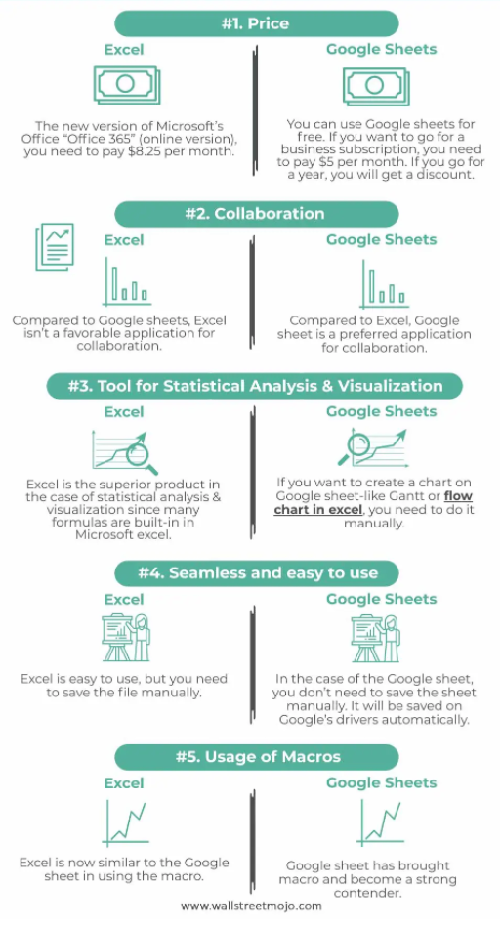

Bottom Line:
Google Sheets is better for collaboration and accessibility
Excel is better for advanced functionality and graphing
Everything in this course we will show how to do in both

Slide 4
Benefits and Shortcomings of Excel
Benefits
Limitations
Ease of use
Data collection and exploration
Widely understood and utilized
Price – R and Python are free to use
Dataset size - ~1,000,000 row max
Statistical power – some packages and tool packs expand on base capability

Slide 5
Basics
Excel Navigation
Opening File - Blank
Headers
Excel/Google Sheets – File, Home/Edit, Insert, Page Layout/Format, Data, View, Help
Formulas – under insert in Google Sheets
Adding/Deleting/Copying Tabs
Copy ‘Raw Uncleaned Data’ tab and rename Data. Add a blank sheet , name it ‘Practice’
Hiding/Deleting rows and columns
Help and Googling
Mathematical functions
Sample Dataset ‘=RANDBetween(1,100)’, copy to numbers not formulas
Sum, Average, Median, Mode, Min, Max, Count, Std Dev, averageif, countif
Shortcut/Helpful functions
Ctrl A, Ctrl D, Ctrl X/V
=formulatext()

Slide 6
Dealing with Messy and Unclean Data
Freeze panes: E – Freeze Top Row, S – Freeze 1 Row
What do we have
URL – Breaks down into ‘/games/’, game name/, platform/, URL Code
Get rid of /games/. Ctrl H find and replace, or Ctrl F
Split, Data -> text to columns
WiiU and Sega CD need to be cleaned up
Proper
Date – Day, Month, Year
Unique function in sheets or date-> remove duplicates in excel/sheets
Categorize Platform and Genre into subsets

